Slide 1


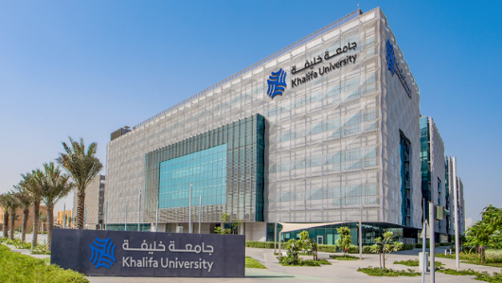
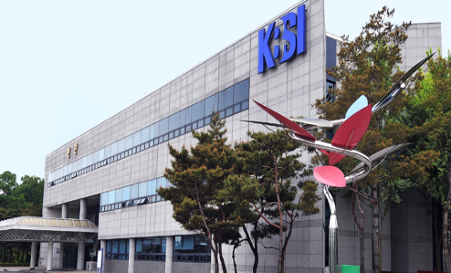
Kores-UAE Joint R&D Technology Center (KUTC)
Daniel Choi
January 10, 2023
Khalifa University of Science and Technology
1

Slide 2
Major Equipment at KUTC (from KU)

Slide 3
Major Equipment at KUTC (From KBSI)
NO | ITEM & MODEL |  | COUNTRY | weight (kg) | Specification (cm)
 | ITEM | MODEL
1 | Drying Oven | VS-4150ND | KOREA | 70 | 68.5 65 100
2 | Fully enclosed reagent cabinet | TOGA-GS22 | KOREA | 250 | 160 54 195
3 | Arium mini Ultrapure Water System | H2O-MA-T | U.S.A. | 20 | 80 80 80
4 | Centrifuge | 5810R | U.S.A. | 99 | 70 54 35
5 | Analytical Balance | Secura224-1SKR | Germany | 5.1 | 36 21.6 32
6 | LCD 4-CH Digital Magnetic Hotplate Stirrer | MS-H340-S4 | CHINA | 9.5 | 69.8 27 12.8
7 | Ceramic Digital Heating Magnetic Stirrer | AREC.X | U.S.A. | 13.2 | 20.3 94 34.4
8 | TUBE FURNANCE | AJ-MBOT1 | KOREA | 150 | 90 50 140
9 | Orion PH Meter | Star A2116 | U.S.A. | 10 | 55 47 20
10 | Ultrasonic Baths | CPX3800H-E | U.S.A. | 5.4 | 39.7 40.1 37.8
11 | Vortex Mixer | SI-0246A | U.S.A. | 4 | 16.5 12.2 16.5

Slide 4
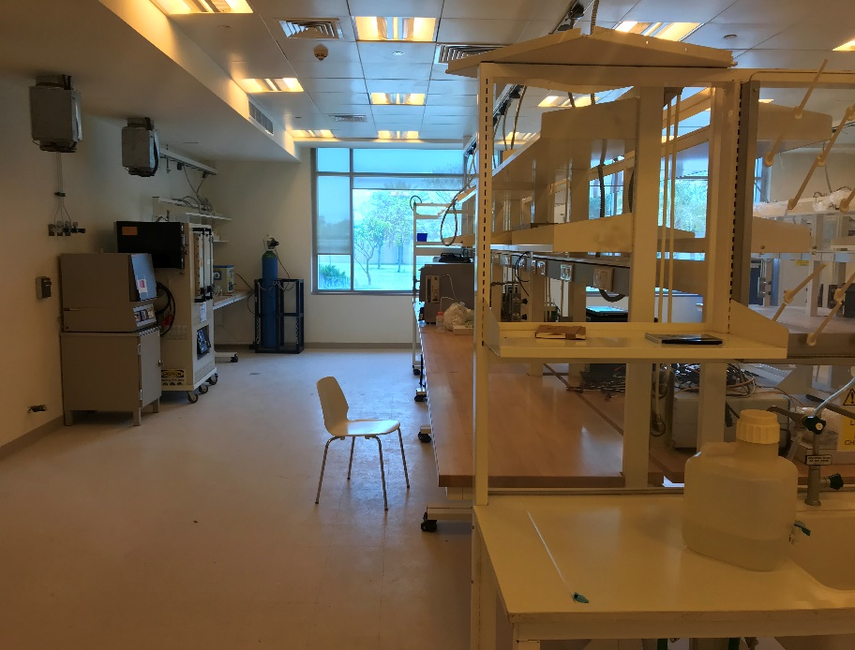
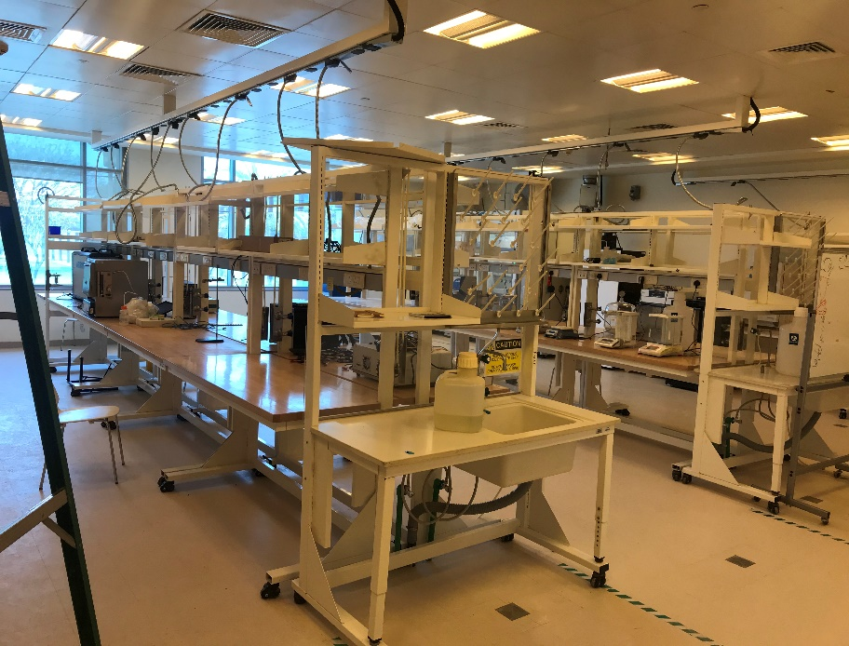
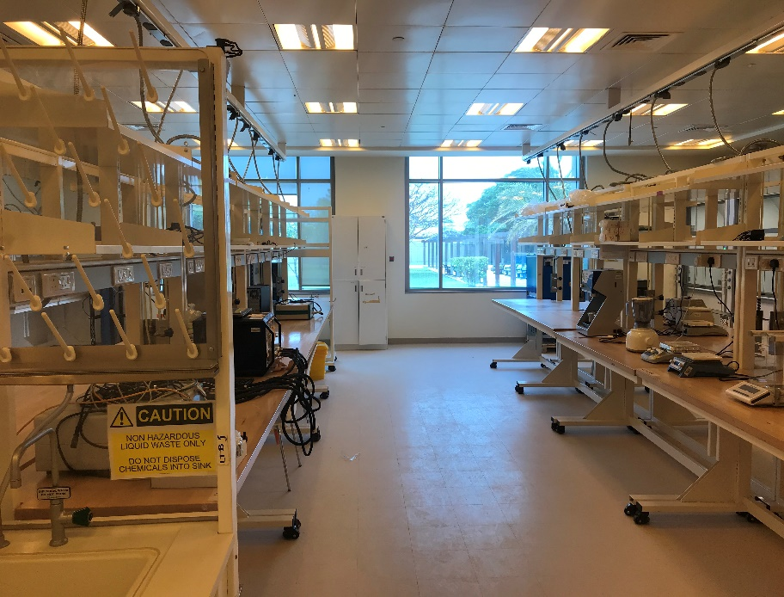
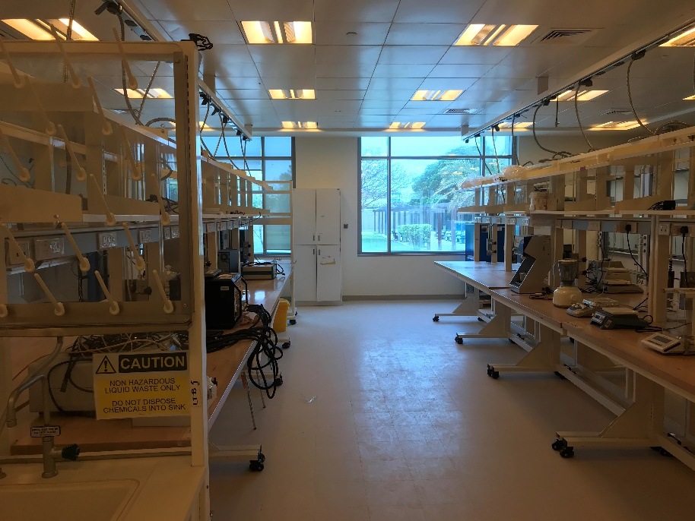
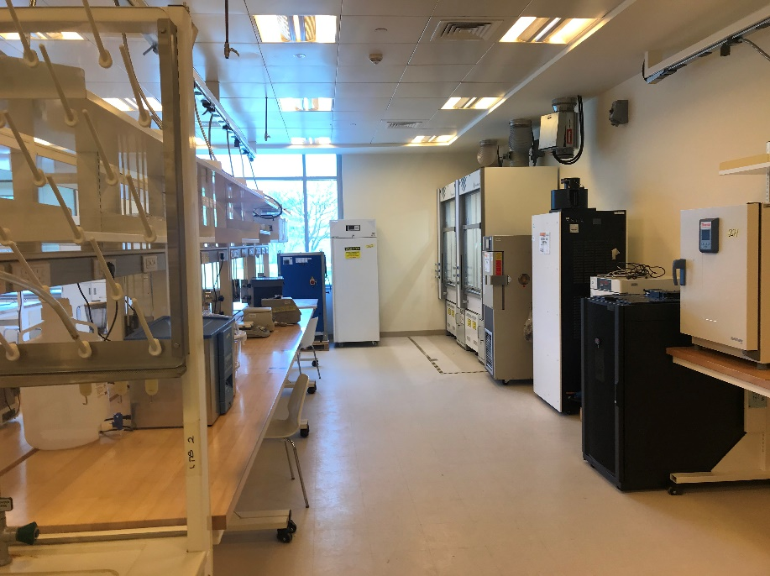
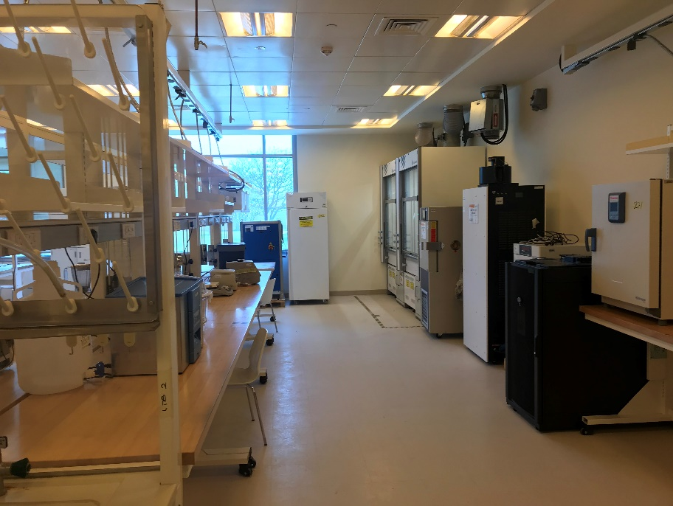
KUTC Lab

